Slide 1

Practical 24
Write a Program to view a tree from left View.

Slide 2

Lesson Plan
Subject/Course | Competitive Coding
Lesson Title | Write a Program to view a tree from left View.
Lesson Objectives
Understand the concept of tree views, especially the Left View of a binary tree.
Learn how to identify and display nodes visible from the left side of a tree.
mplement the Left View logic using Level-Order (BFS) and Depth-First (DFS) traversals.
Analyze the time and space complexity of both approaches for efficiency comparison.

Slide 3
Problem Statement:
Write a Program to view a tree from left View.

Slide 4
Concept
A Binary Tree can be viewed from different angles — left, right, top, bottom. The Left View includes only the leftmost nodes at each level.
We can find it using:
Level-Order Traversal (BFS) — using a queue.
Depth-First Search (DFS) — using recursion and level tracking.

Slide 5
Algorithm/Logic
Approach 1 — BFS (Level Order):
Initialize a queue and push the root node.
For each level, process all nodes — print the first node of that level.
Enqueue left and right children of each node.
Approach 2 — DFS (Recursive):
Start from the root with level = 1 and maxLevel = 0.
If current level > maxLevel, print the node and update maxLevel.
Recur left, then right.

Slide 6
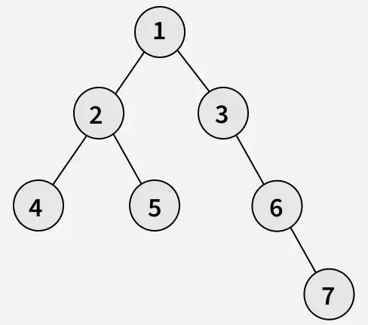
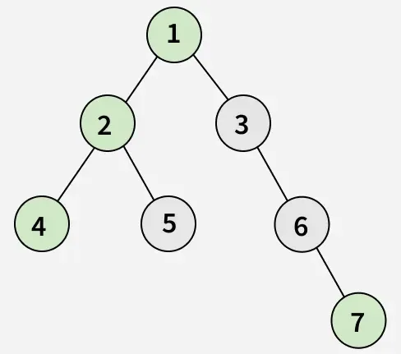
Visualization
Output: [1, 2, 4, 7]
Explanation: From the left side of the tree, only the nodes 1, 2, 4 and 7 are visible.

Slide 7
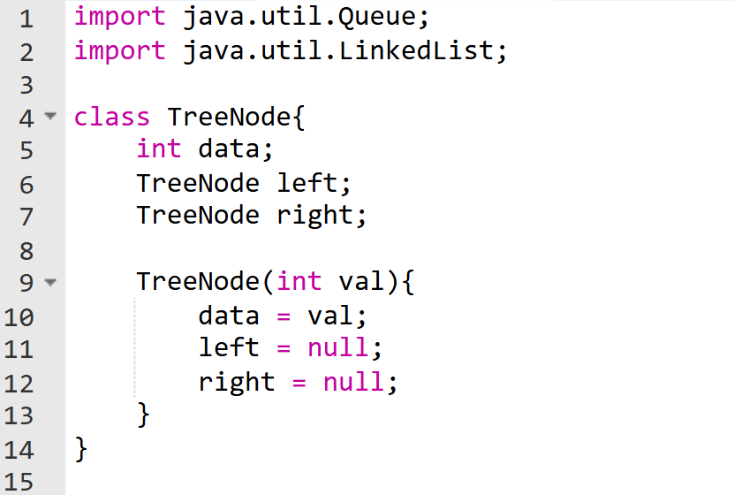
Code Implementation

Slide 8
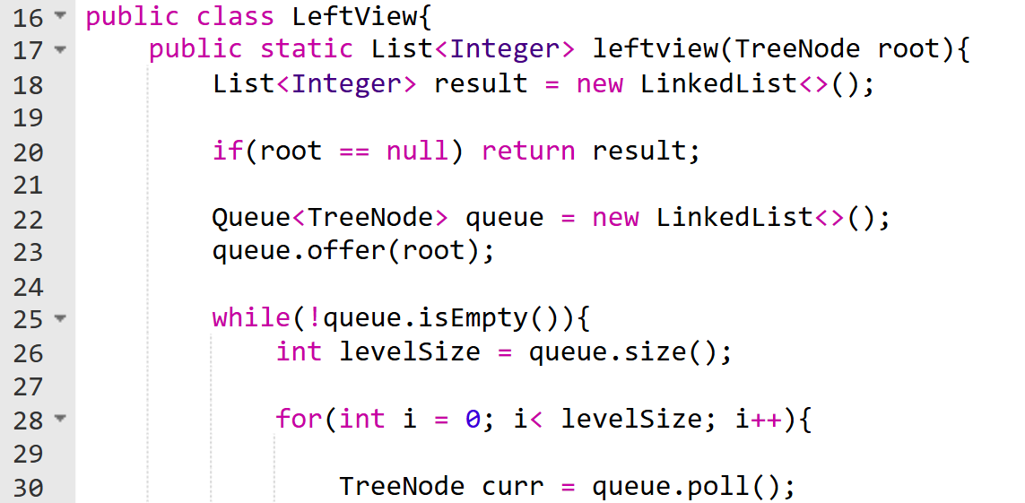
Code Implementation

Slide 9
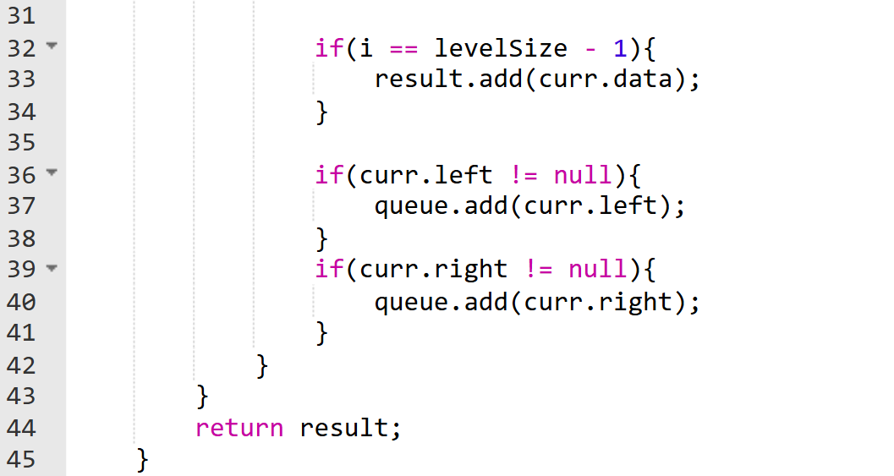
Code Implementation

Slide 10
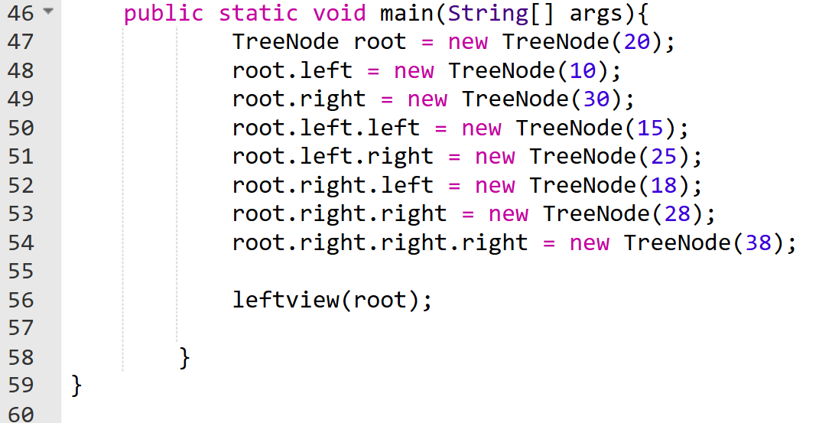
Code Implementation

Slide 11
Time & Space Complexity
Approach | Time Complexity | Space Complexity
BFS | O(n) | O(width of tree)
DFS | O(n) | O(height of tree)

Slide 12
Summary
The Left View of a binary tree shows all nodes visible from the left side.
Can be implemented using BFS (iterative) or DFS (recursive) traversal.
Both have O(n) time complexity.
Commonly used in visualization, tree analysis, and real-world rendering algorithms.

Slide 13
Practice Questions:
1️⃣ Binary Tree Right Side View — LeetCode #199
🔗 https://leetcode.com/problems/binary-tree-right-side-view/
Concept: Use DFS with depth tracking. Traverse right-first, and when a level is visited for the first time, record the node.
Why Practice: This is the closest DFS equivalent to Left View. Left View = left-first DFS Right View = right-first DFS

Slide 14
Practice Questions:
2️⃣ Binary Tree Paths — LeetCode #257
🔗 https://leetcode.com/problems/binary-tree-paths/
Concept: Use DFS recursion to build root-to-leaf paths, passing state (path string) down the recursion.
Why Practice: Builds confidence in DFS traversal with level/state awareness, which is essential for Left View using DFS.

Slide 15
Practice Questions:
3️⃣ Balanced Binary Tree — LeetCode #110
🔗 https://leetcode.com/problems/balanced-binary-tree/
Concept: Use DFS (postorder) to compute height differences while returning information upward.
Why Practice: Teaches depth handling and recursion control, the same mental model used when tracking levels in DFS-based Left View.

Slide 16
Thanks

